Slide 1
An Introduction to
Neural Networks
Satchit Chatterji
MSc Artificial Intelligence
University of Amsterdam
satchit.chatterji@gmail.com
June 24th, 2024
Notes:
Introduce myself
How many of you have used ….
Know what an nn is already
Understanding the nature of human intelligence. We are symbolic creatures that can string together symbols to make symbolic stories, despite everything in our heads being just these strange, complicated series of cells with distributed information flowing through in the form of chemistry, electricity and black magic.
During the next hour, I’ll be your guide to the realm of artificial abstractions or approximations of neurons, unsurprisingly called artificial neural networks, and try and answer why, as physics students, may want to use them for trigger and data acquisition. You can also ask questions whenever you have them during the lecture. There’s a lot to cover, so strap in! Let me know if I’m going too fast.

Slide 2
Introduction to Neural Networks, Backpropagation, and Gradient Descent
Zonghua Gu
Jun 01 2026, Memorial University
Notes:
Towards Safe and Efficient Resource-Constrained AI-Enabled Cyber-Physical Systems

Slide 3
Overview
Goals of this lecture:
- Explain what a neural network is and how it works
- Why you should use them, and why not
- Which neural networks are used today
- Where neural networks are headed next
Outline:
- Building a Neural Network from Scratch
- Gradient Descent
- Types of Neural Networks
- Training tips
Notes:
A word of warning

Slide 4
ML Training paradigms
Supervised (focus of this lecture)
  Train a model with explicit input-output pairs
Unsupervised
  Learns “patterns” from unlabelled data
Semi-supervised learning
  Learn a few things with input-output pairs, relate them to patterns learnt unsupervised
Reinforcement Learning
  Learn an optimal “policy” that gives you the best action to take at any given state space by taking random actions and learning through positive or negative reinforcement.
Notes:
Okay let’s get back to neural networks Evolution
Optimize parameters through (Darwinian) evolution; e.g. genetic algorithms.

Slide 5



Supervised Learning
Given: Input-output examples of the form:
Assumption: Data is generated by a “true ” function, with some added noise:
Goal: Learn an approximation of the generator function to use on new data:
Loss function: A distance between and such that we can say is “good” if L is low across many given instances of S.

Slide 6
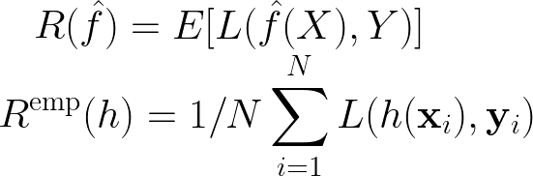
Aim: Learn a function with low “risk”
Risk: What we want to minimize
Empirical Risk: What we can actually calculate (loss for a “candidate” model h, averaged over N training examples)
Slide adapted from Jaeger, H. (2022) Neural Networks Lecture Notes, https://www.ai.rug.nl/minds/uploads/LN_NN_RUG.pdf

Slide 7
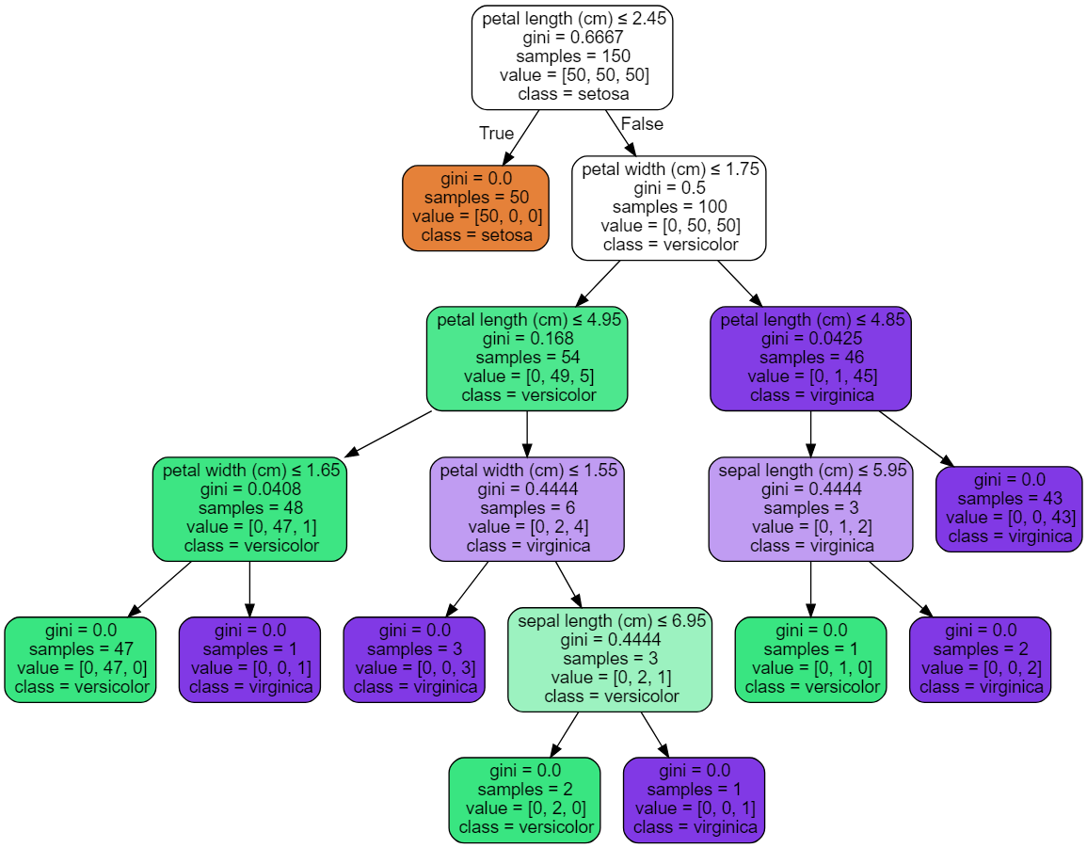
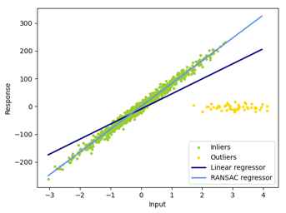
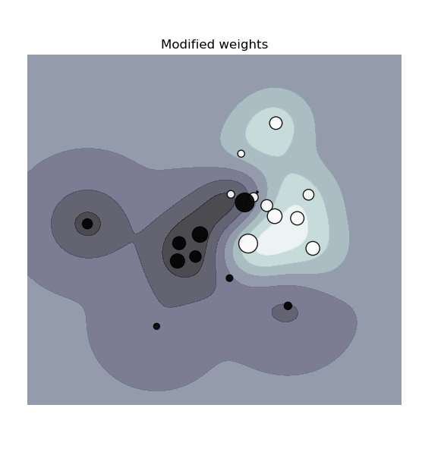

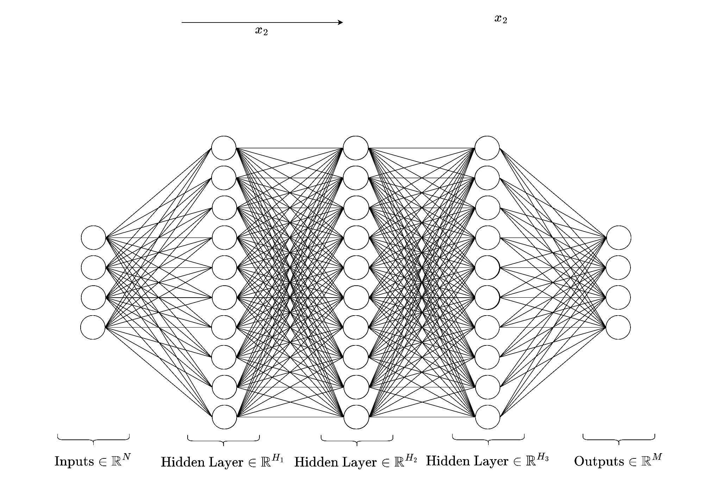
Common Approaches
Linear/Polynomial/Logistic Regression
(Boosted) Decision trees
Support Vector Machines
Naive Bayes
Neural Networks
…
Images of regressions, decision tree, and SVM from scikit-learn.org
Notes:
But where do neural networks come from?

Slide 8
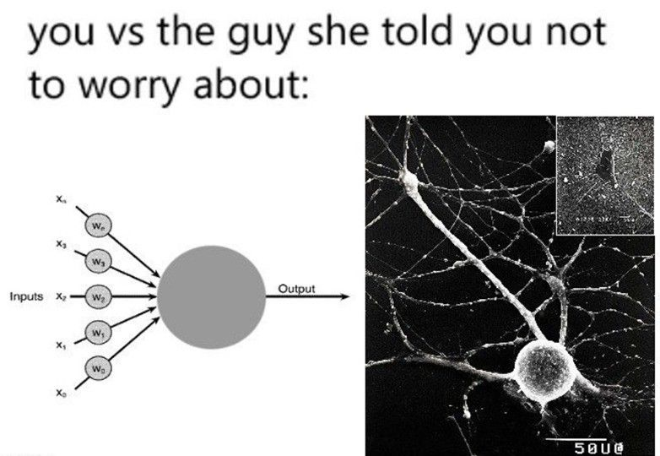
Artificial vs Biological NNs
ANNs initially inspired by the brain:
Alexander Bain (1873), William James (1890)
Electrical connections/flow of neurons result in thought
and movement
McColloch & Pitts (1943)
Modern mathematical “artificial” NN models
Rosenblatt (1958)
Description of the perceptron
Rumelhart, Hinton & Williams (1986)
Multi-layer perceptrons and error backpropagation (learning principle)
Modern:
- ANNs used everywhere for everything!
- Simplified, abstracted version of biological neurons
- Biologically implausible
- Yann LeCunn calls them “units” instead of “neurons”
linkedin.com/company/deeplearningai
Notes:
(not the only neural network model!)

Slide 9
Building a Neural Network
From Scratch
Notes:
Timestamp: 00:10

Slide 10
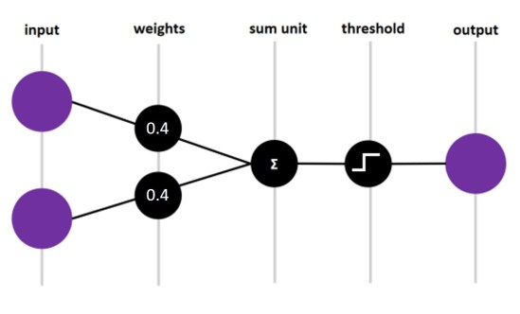
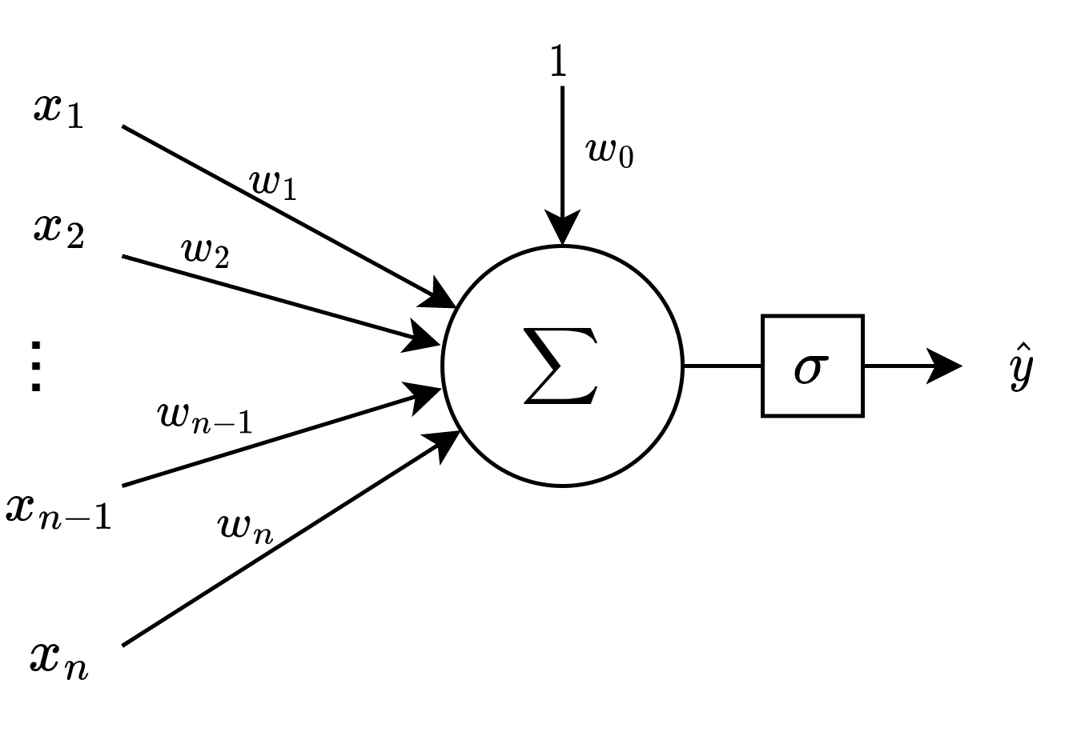
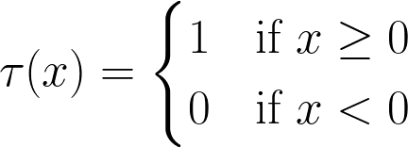

Perceptron
$$σ$$
Activation function
An example of perceptron w/ 2 inputs and binary threshold activation function.
A single “neuron”
Only works on linearly separable classes

Slide 11
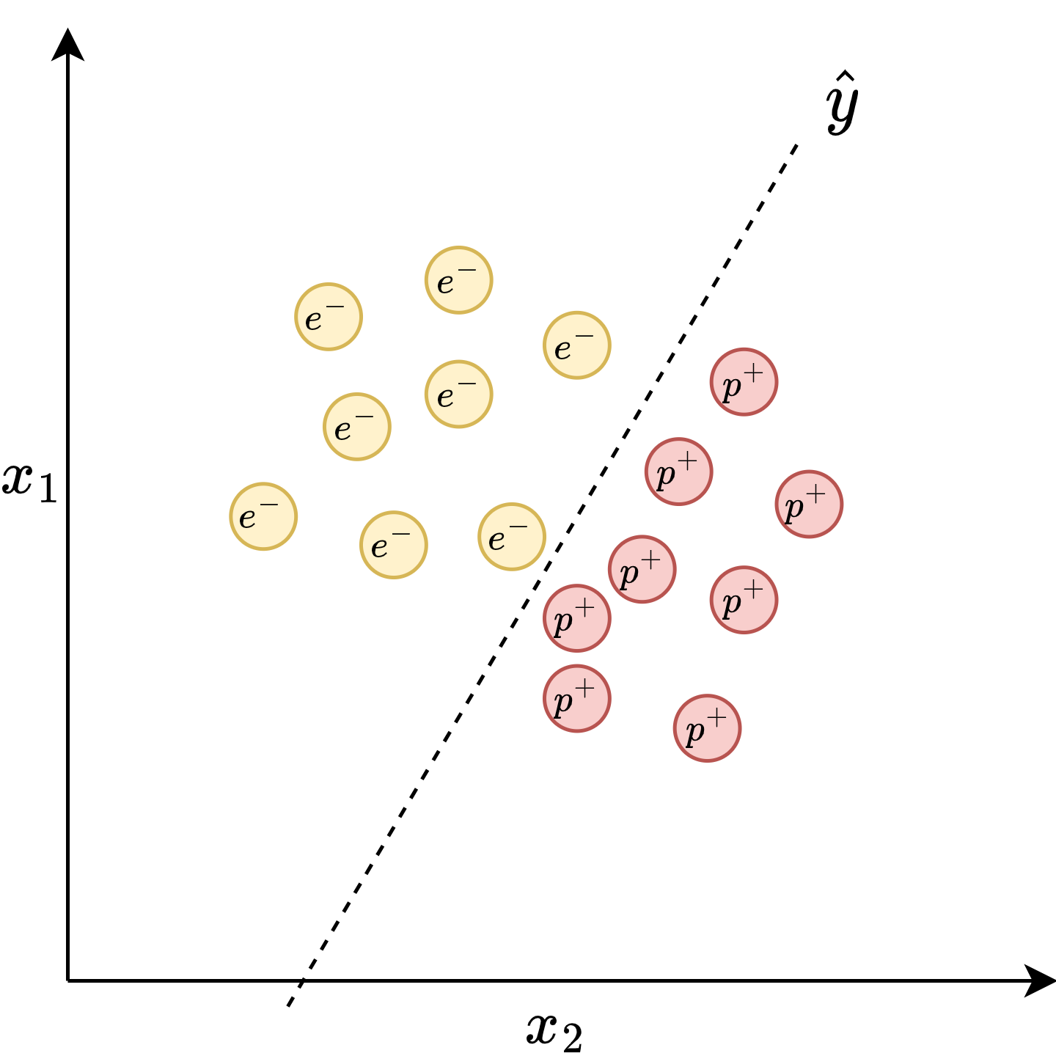
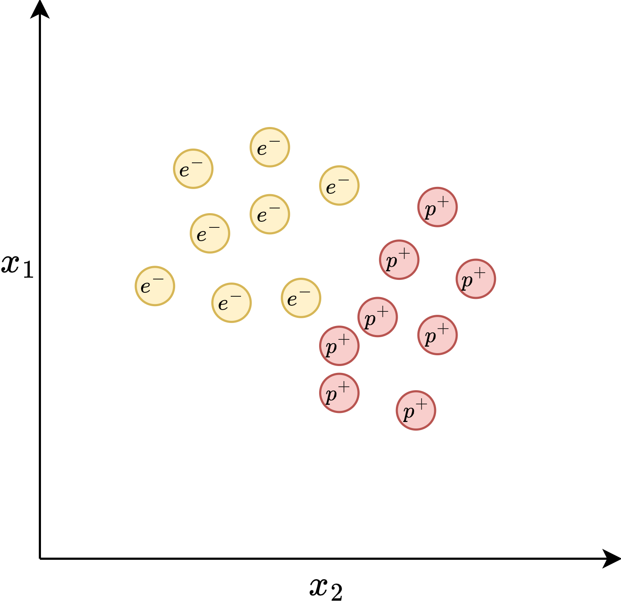
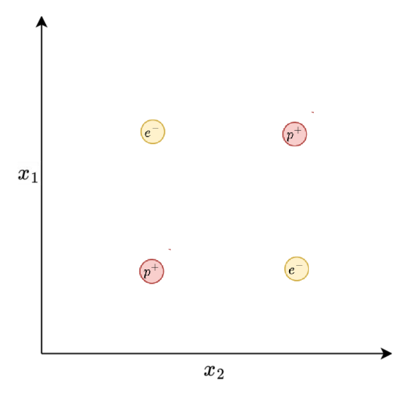
Two classes are linearly separable
Two classes are not linearly separable: no single straight line can separate them

Slide 12
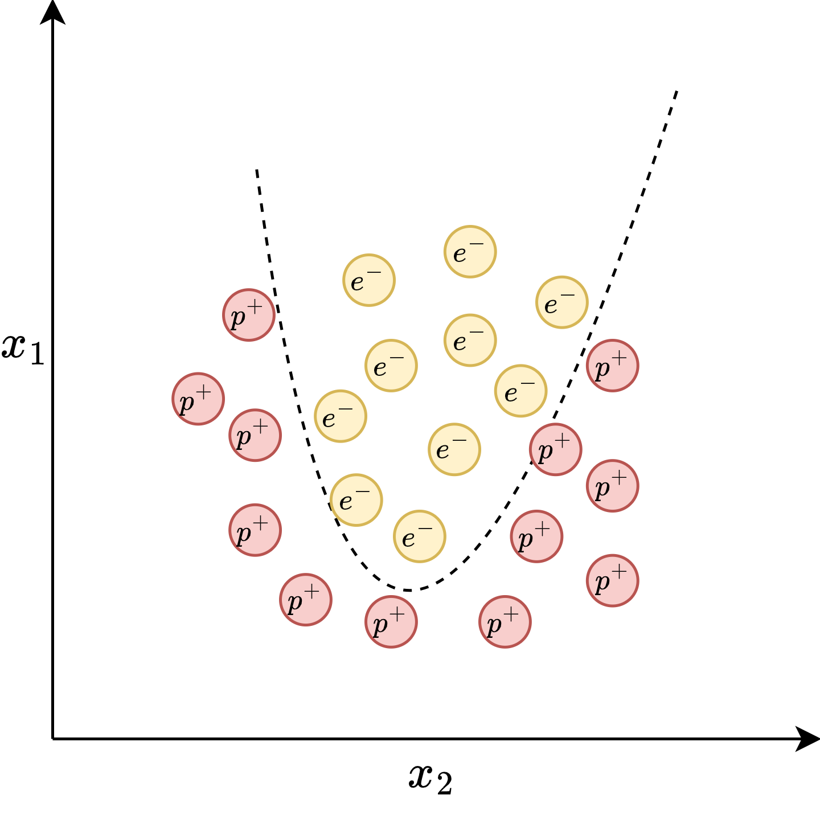
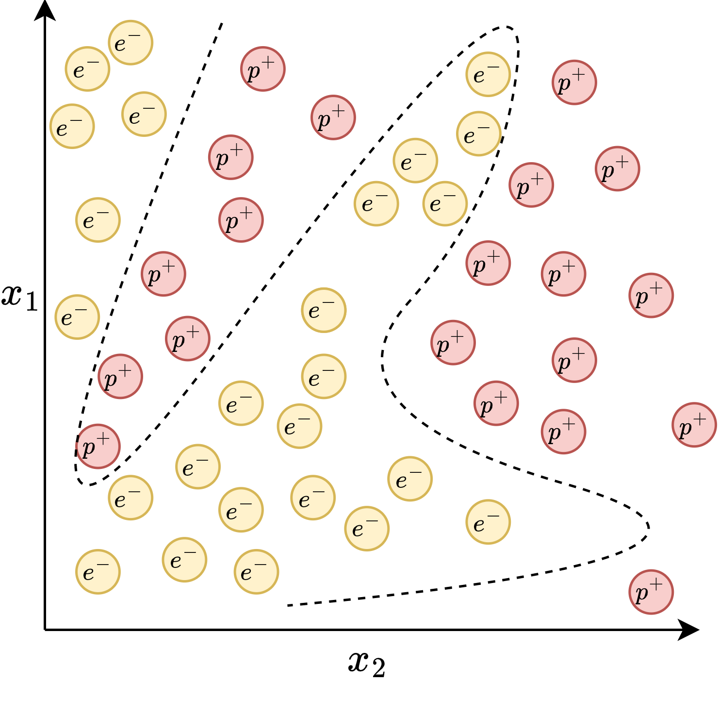
More cases of non-linearly-separable datasets
Notes:
In reality we often get things that are not approximable with lines. What if you want to model a more complex function?

Slide 13
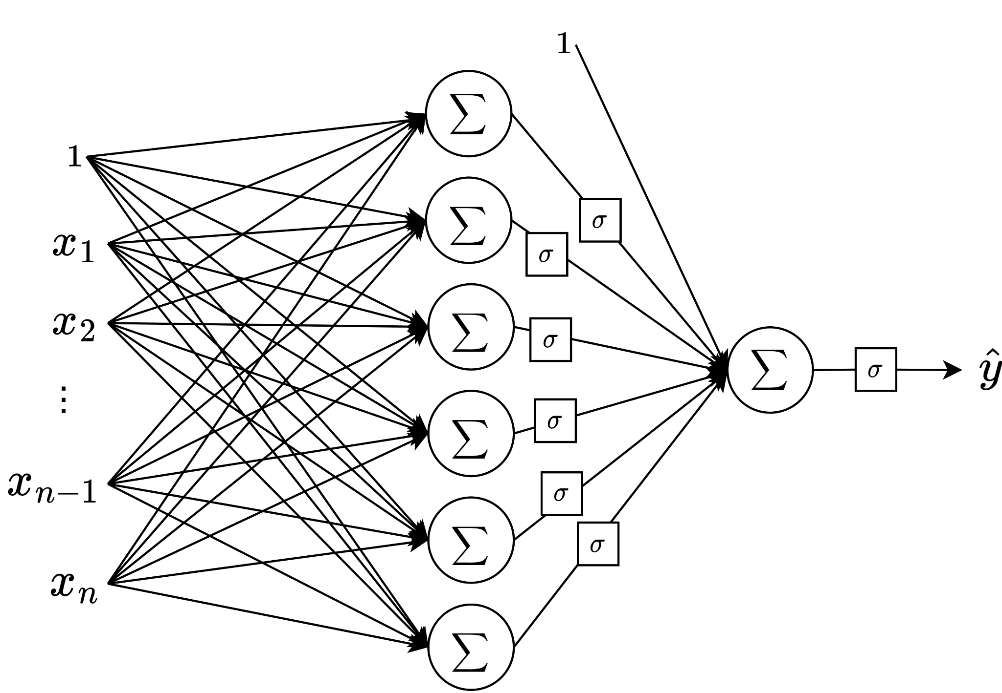
Multi-layer Perceptron (MLP)
…
If we put multiple perceptrons together, with one or more hidden layers, then we can approximate a complex function as a piecewise linear function, making it work for non-linearly-separable datasets.
Notes:
Let’s get back to the perceptron. What if we could chain them together in something like a layer? Maybe we could approximate little bits of our complicated functions as little lines and combine them to get a sort of complicated piecewise function?

Slide 14
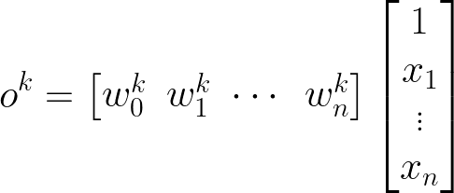
Activation/
output
of neuron k
“Weight vector”
“Feature vector”
K "hidden” neurons
in layer L

Slide 15
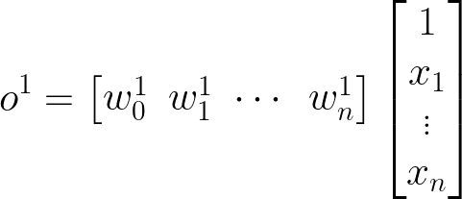
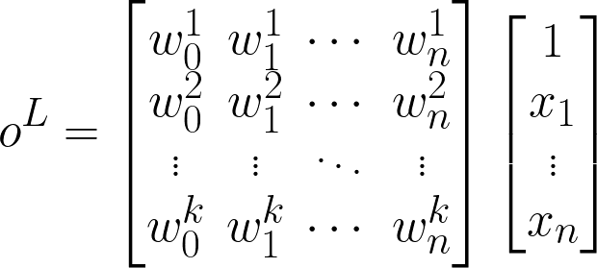
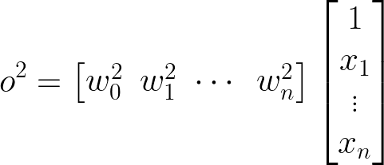
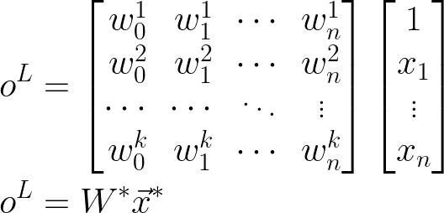
Notes:
Can you see what’s gonna happen next?

Slide 16
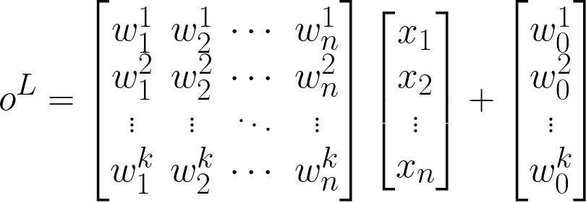
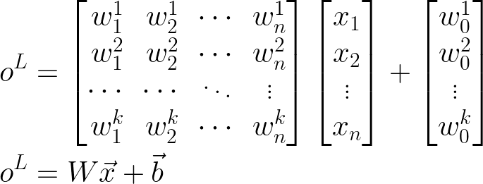

Output of each layer is the product of its weight matrix and the input vector plus its bias vector, followed by a non-linear activation function.
$$\hat{y}=σ(o^{L})$$
“Activation”
“Bias”
“Activation function”
Notes:
Most common way of writing out the activation of a layer of an MLP

Slide 17
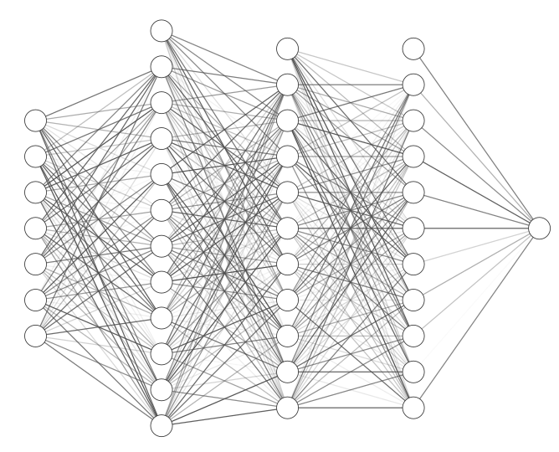


A multi-layer perceptron is a series of affine transformations of an input vector, each of which is wrapped in a non-linear activation function.
Without a non-linear activation function, a series of linear transformations would result in just a linear transformation of the input to the output.
Notes:
Okay just to recapWithout a non-linear activation function, a series of linear transformations would result in just a linear transformation of the input to the output.
We would still be stuck in the land of linear separability!

Slide 18
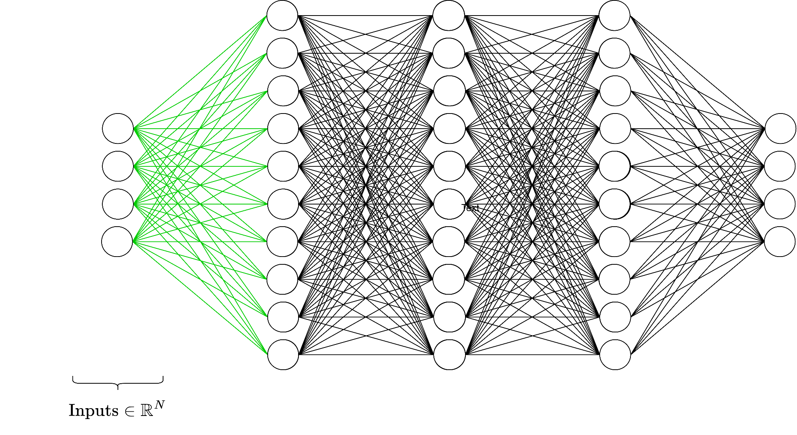

Slide 19
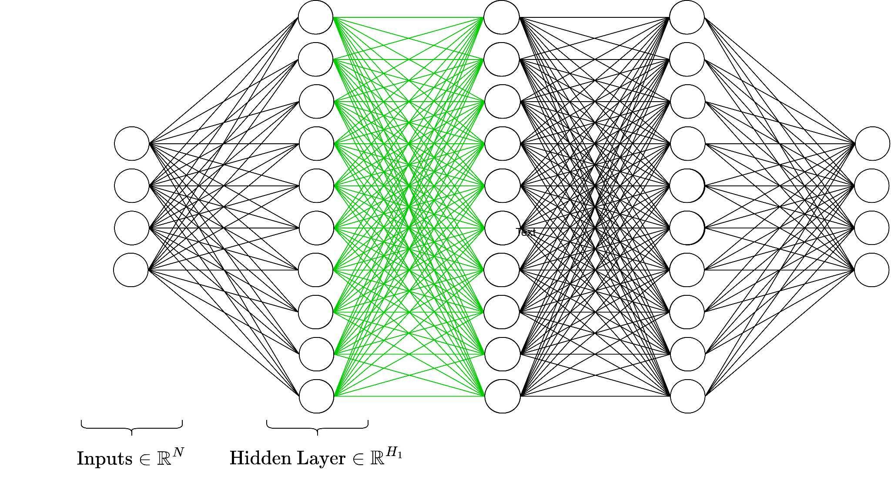

Slide 20
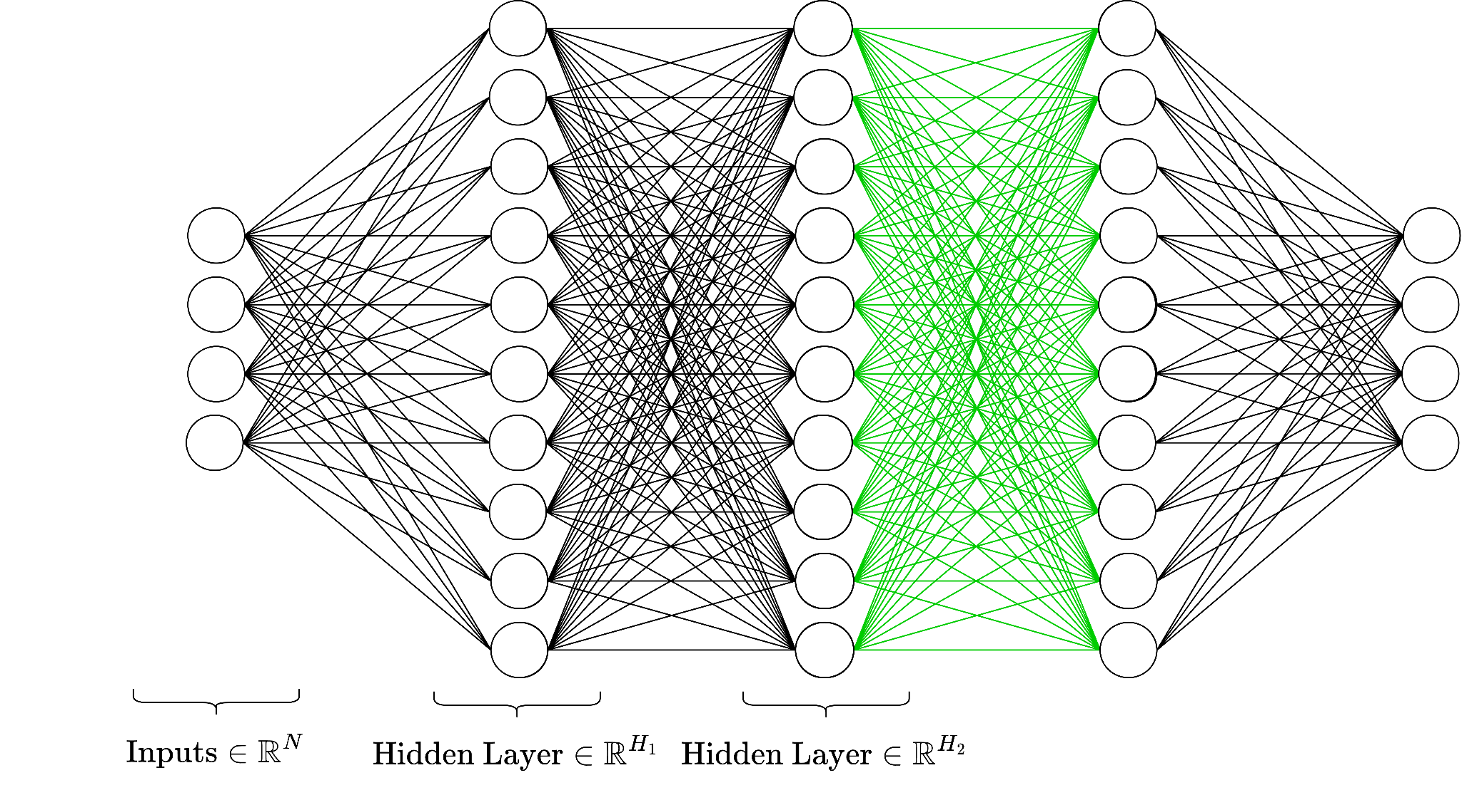

Slide 21
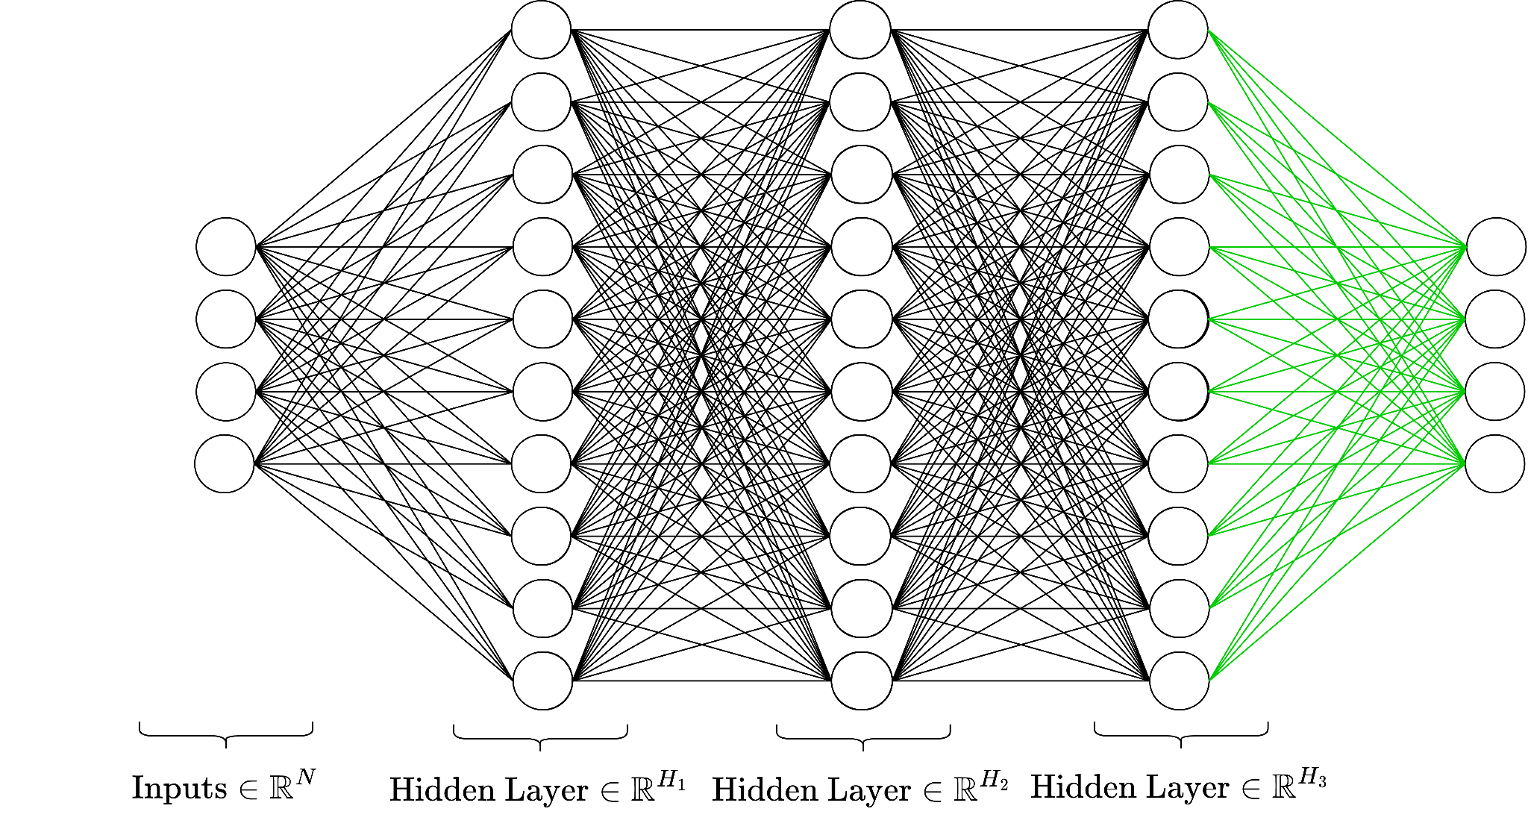

Slide 23
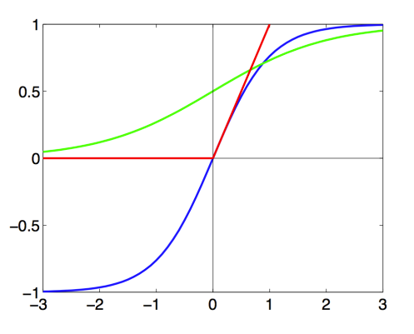


Common nonlinear functions

Slide 24
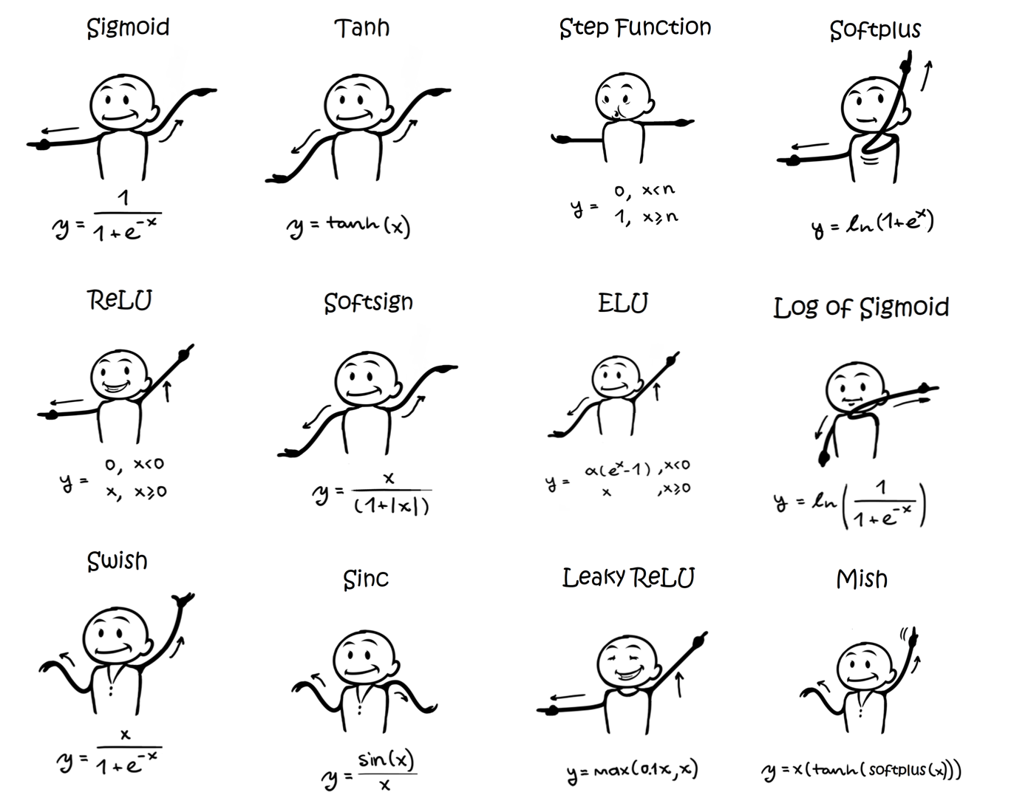
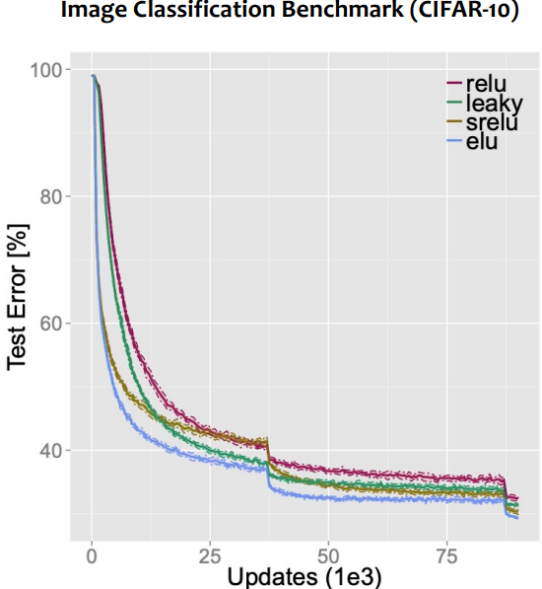
Clevert et al. (2016): Training loss converges fastest with ELU; ELU yields lower test error than ReLU on CIFAR-10
https://sefiks.com/2020/02/02/dance-moves-of-deep-learning-activation-functions/

Slide 25
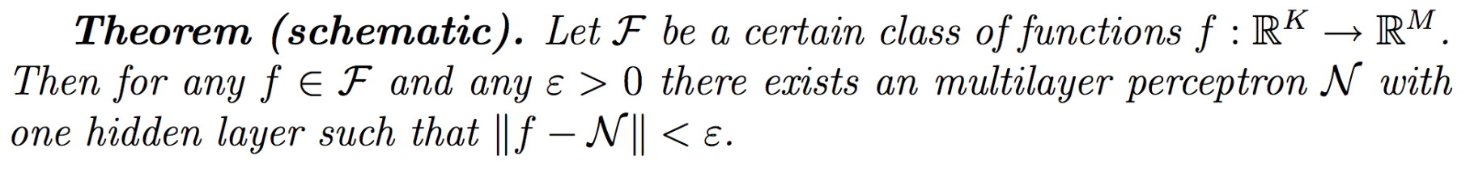
Universal Approximation Theorem
⇒ We can approximate any function we want with a one-layer MLP!
More effective with more layers than just one (“deeper” networks)
Notes:
Easier said than done in practice
Schematic borrowed from Jaeger, H. (2022) Neural Networks Lecture Notes, https://www.ai.rug.nl/minds/uploads/LN_NN_RUG.pdf
Collection of proofs: https://ai.stackexchange.com/questions/13317/where-can-i-find-the-proof-of-the-universal-approximation-theorem

Slide 26
Gradient Descent
Notes:
Timestamp: 00:10

Slide 27
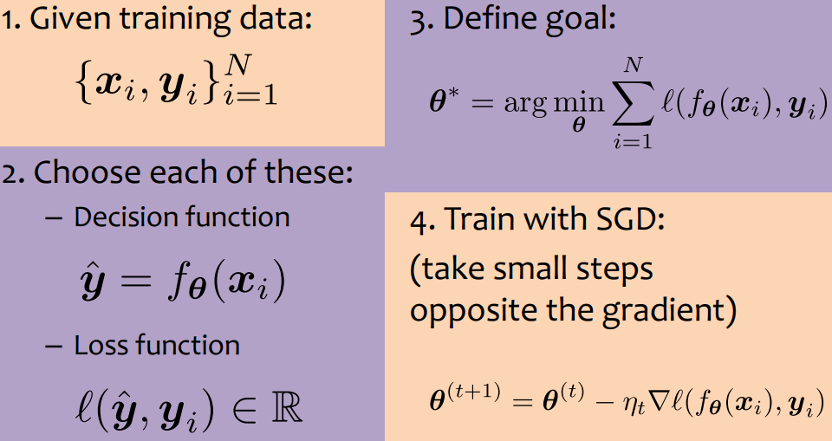
General ML Recipe
https://www.cs.cmu.edu/~mgormley/courses/10601-s23/slides/lecture12-backprop.pdf

Slide 28
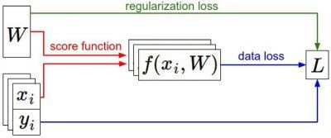
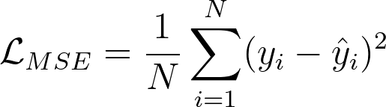
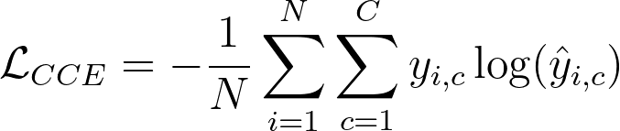
Loss functions
Depends on the task
Mean Squared Error (MSE)
Used for regression
Cross Entropy
Used for classification
Many others
Note: Must be differentiable for gradient descent based optimization
Regularization loss: constrain weights to be sparse or small

Slide 29
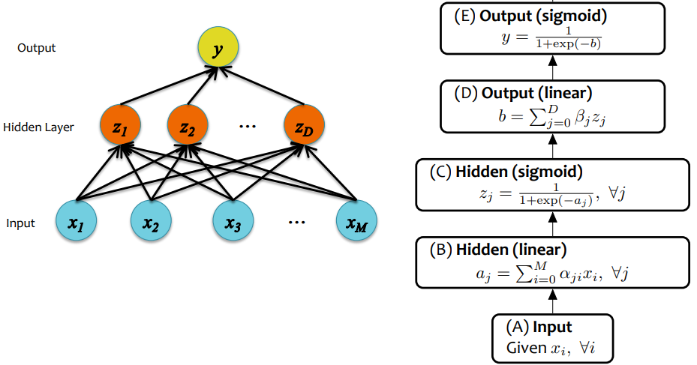
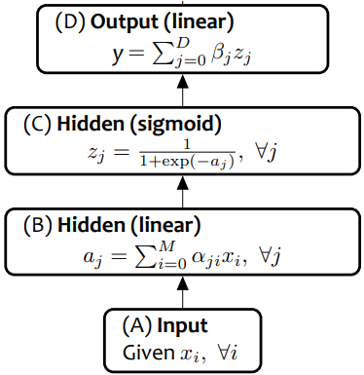
Binary Cross Entropy loss
MSE loss
NN for Binary Classification
NN for Regression

Slide 30
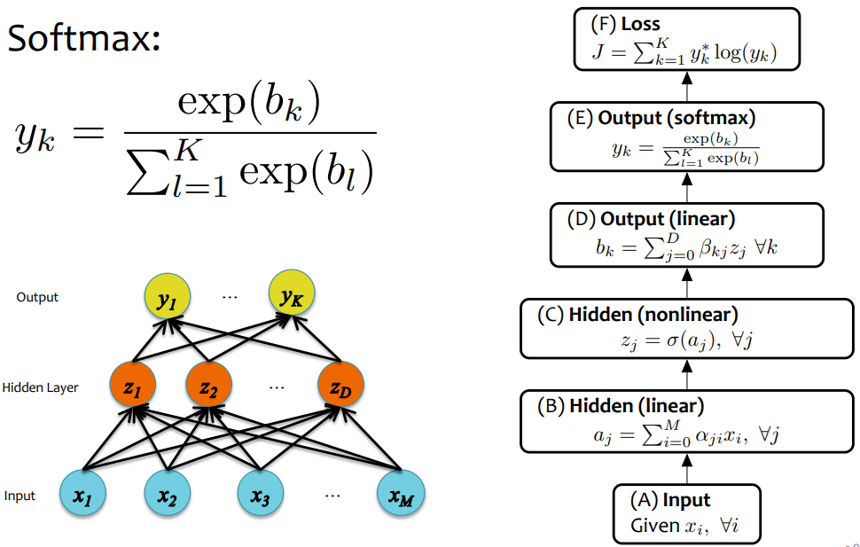
Cross Entropy loss
NN for Multi-Class Classification

Slide 31
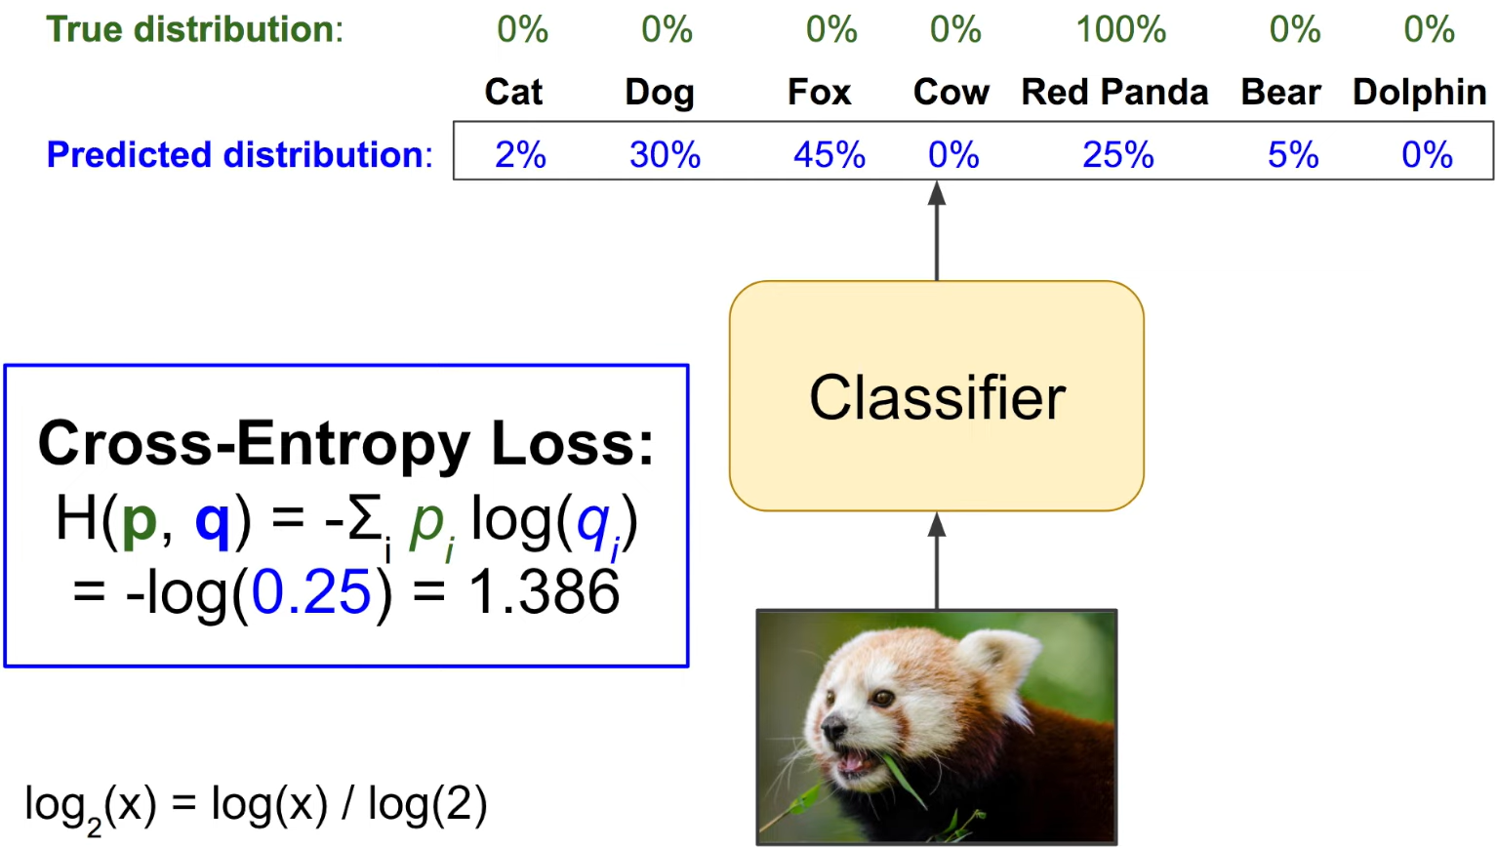
Cross Entropy Loss Example
For a given training sample, CE loss measures how much the predicted distribution diverges from the true distribution, which is a one-hot vector: the entry corresponding to true label being 1 and all others 0.
A Short Introduction to Entropy, Cross-Entropy and KL-Divergence
Notes:
A Short Introduction to Entropy, Cross-Entropy and KL-Divergence
https://www.youtube.com/watch?v=ErfnhcEV1O8

Slide 32

Implementing learning: Gradient Descent
Given:
Family of parameters (e.g. possible weights of a NN)
Differentiable risk function (loss function computed over a set of samples)
Goal:

Slide 33
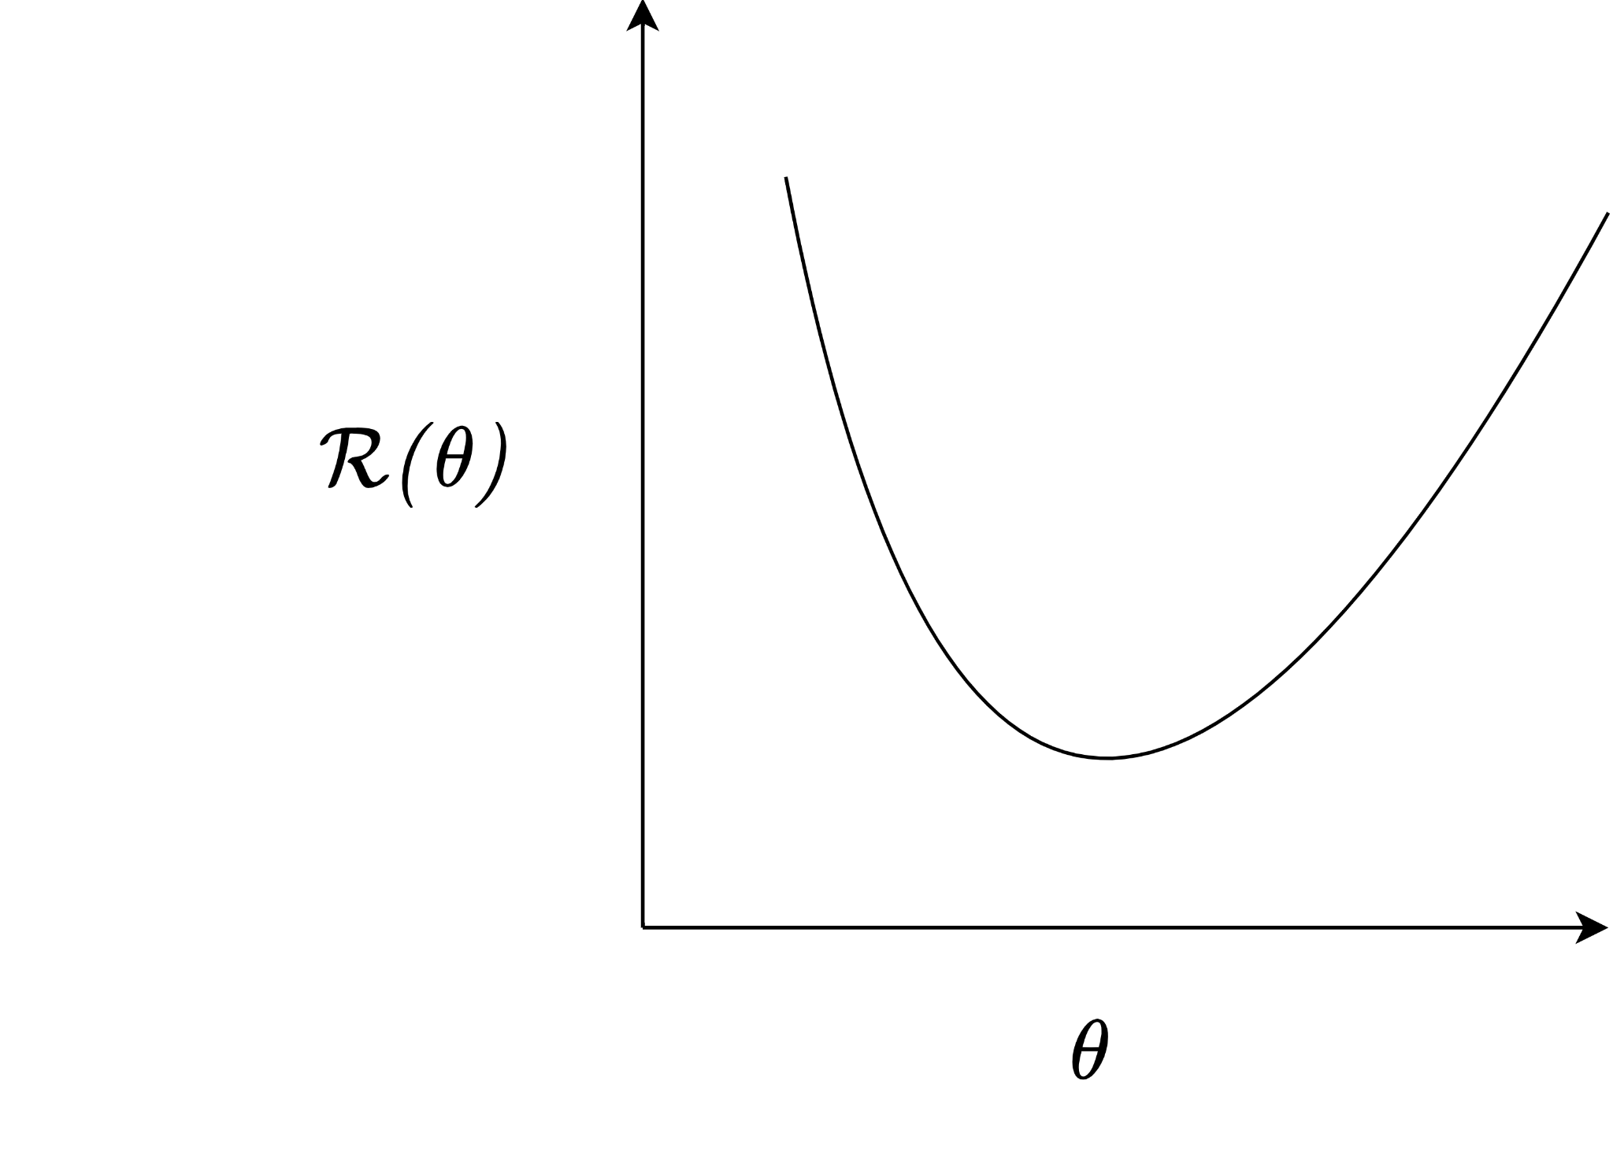
Backprop: Gradient descent

Slide 34
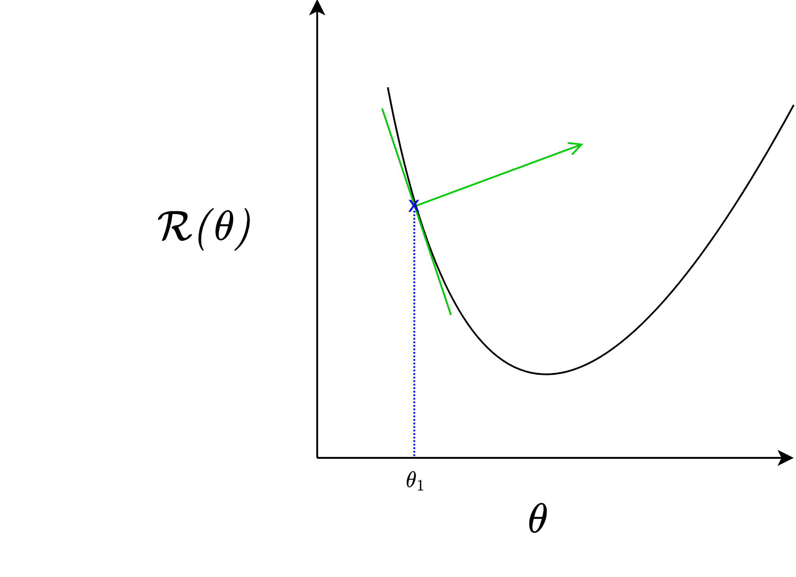

“Learning rate”
“Guess”

Slide 35
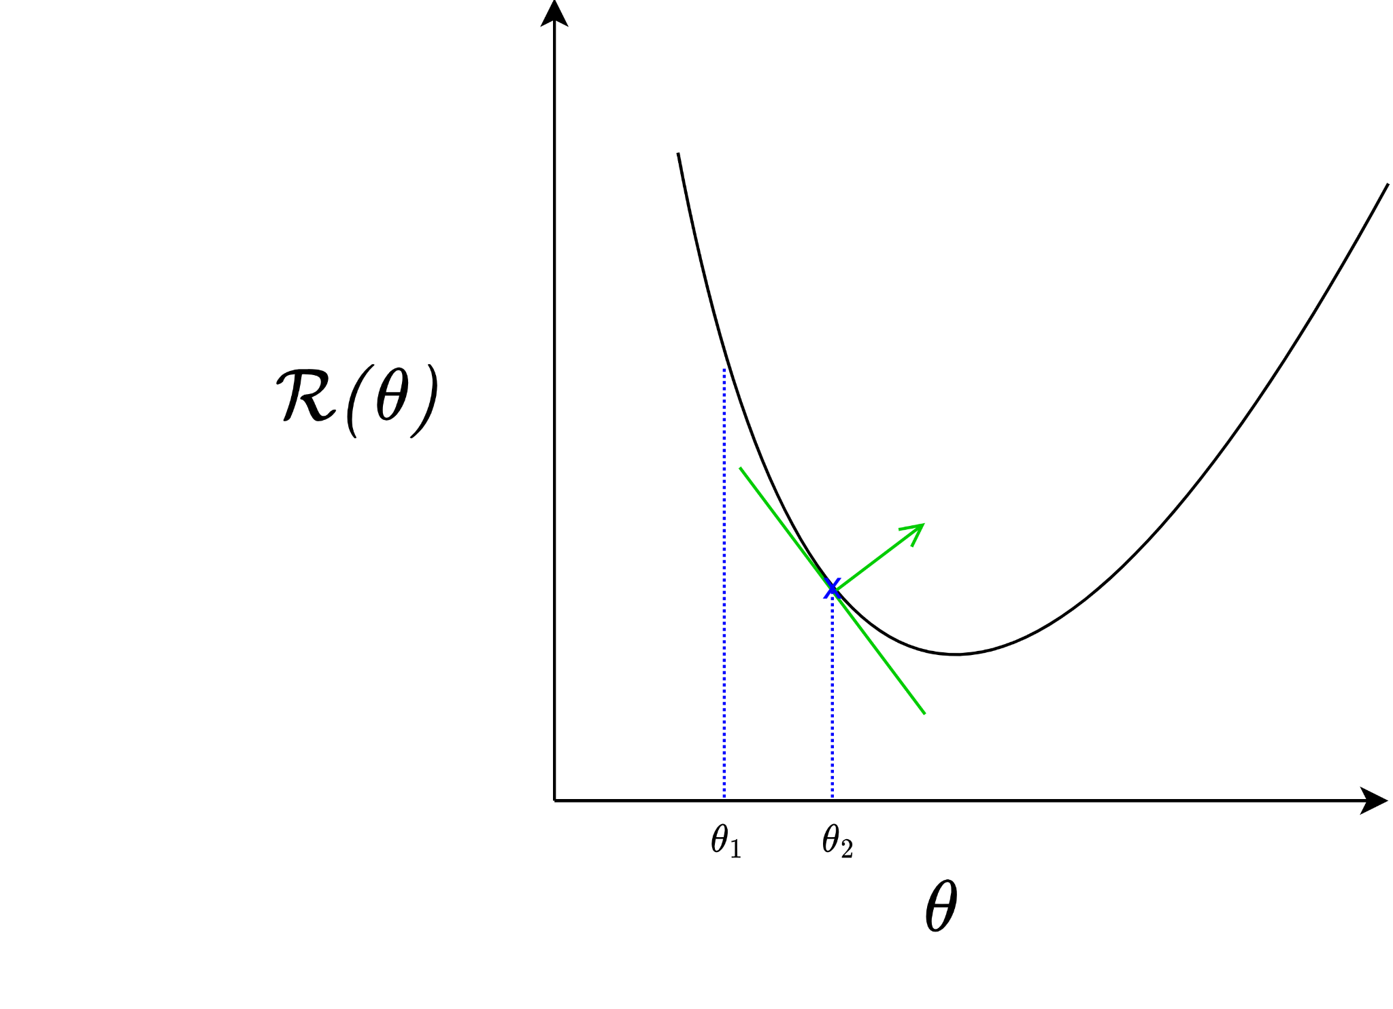

Slide 36
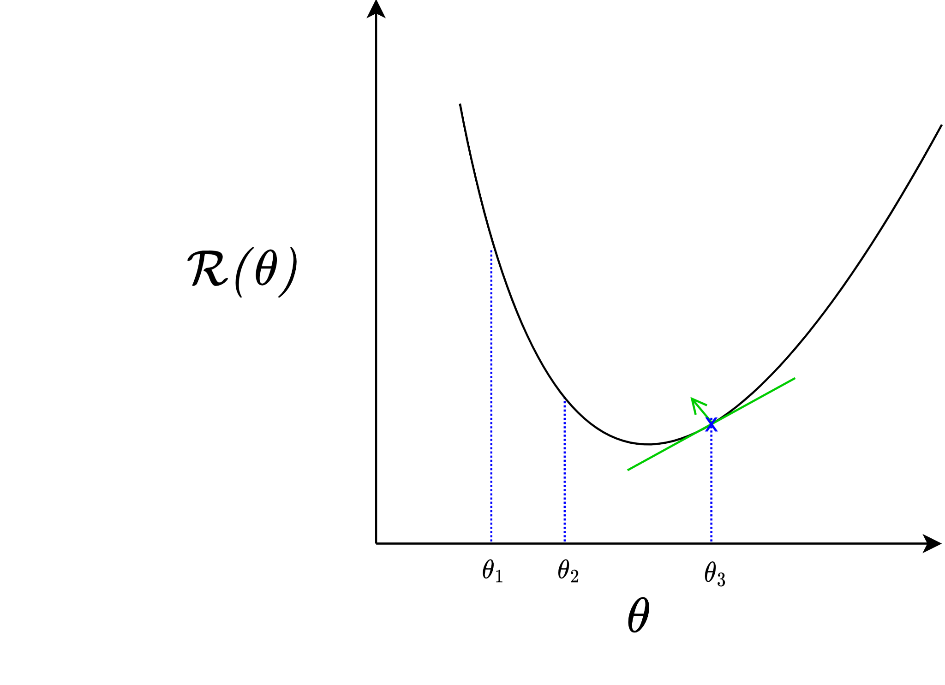

Slide 37
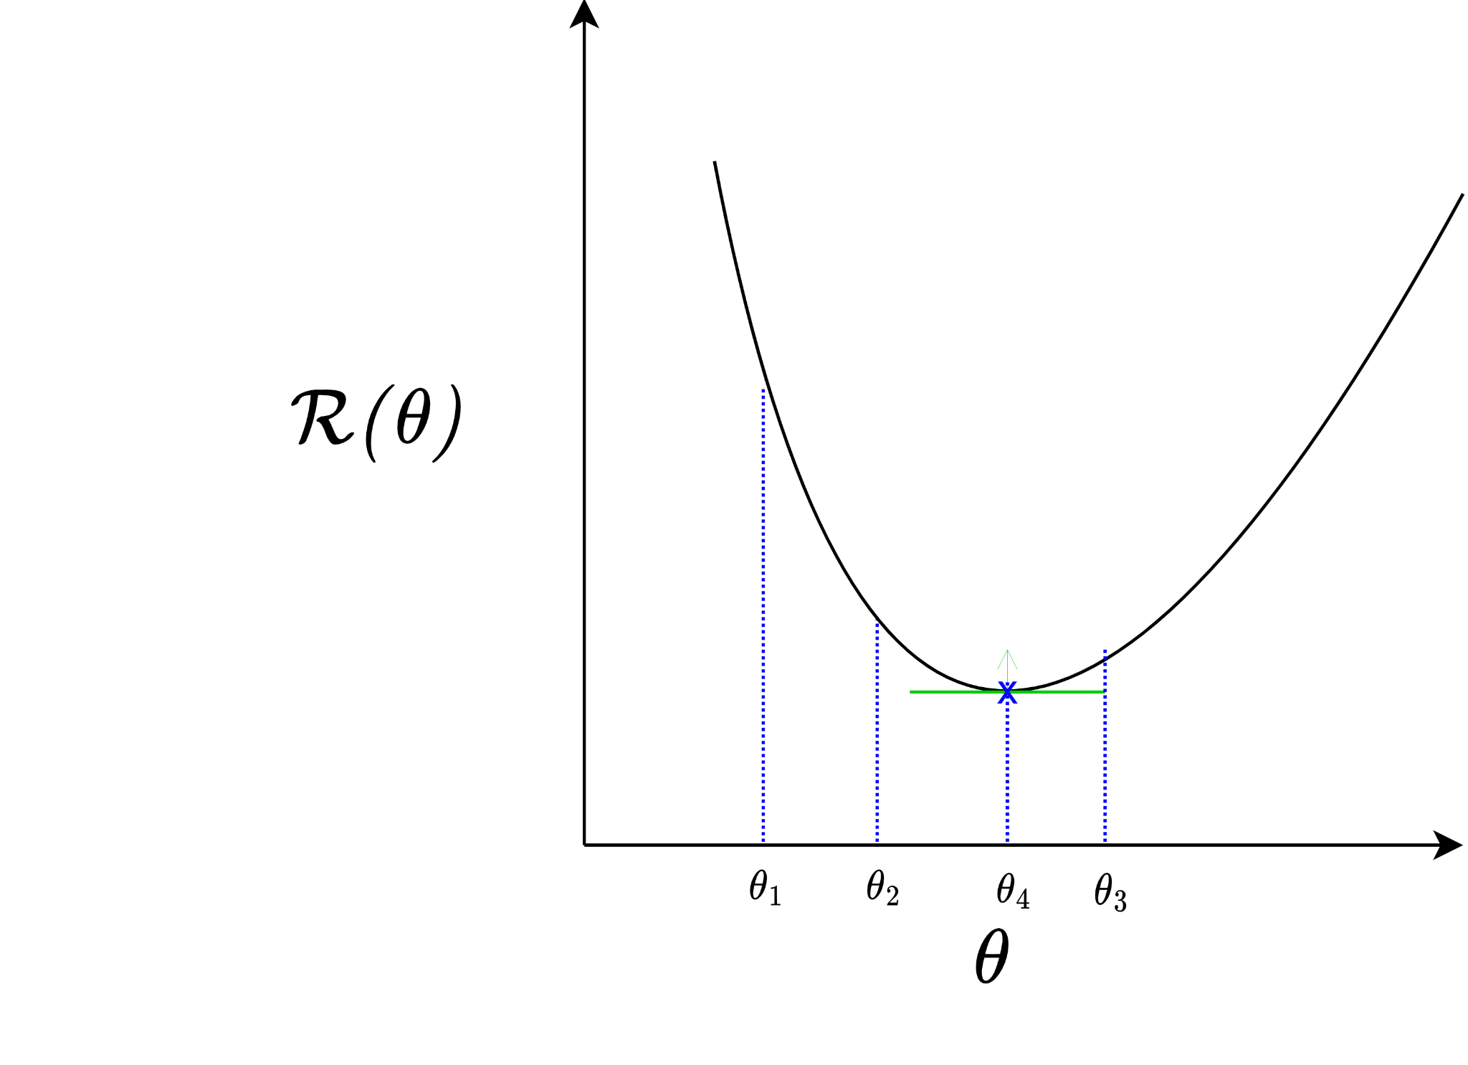
Converges to local minima

Slide 38
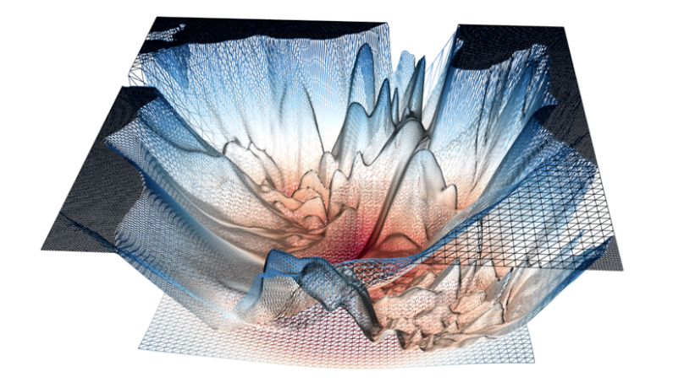
A “real” loss landscape:
Many (many many) local minima
Saddle points
http://www.telesens.co/2019/01/16/neural-network-loss-visualization/

Slide 39
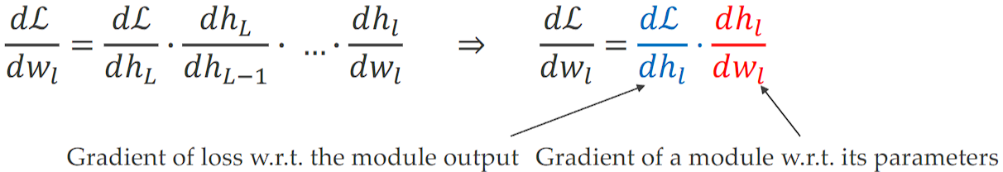


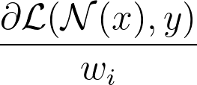
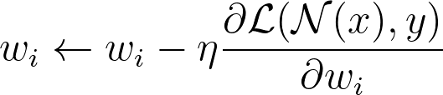

Backprop: Efficient NN GD
Apologies for different notation
Goal: change optimization from to
Recall an MLP:
Use the chain rule to compute the derivatives from output to input
“Backpropagation of errors”

Slide 40

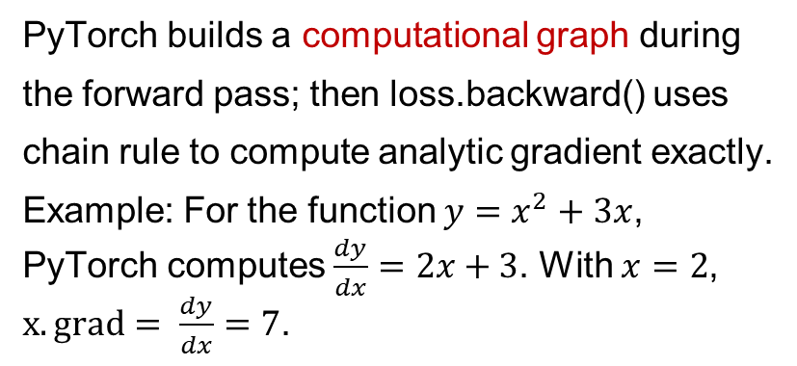
Gradient Descent
PyTorch builds a computational graph during the forward pass; then loss.backward() uses chain rule to compute analytic gradient ​exactly.
Example: For the function $y=x^{2}+3x$, PyTorch computes $\frac{dy}{dx}=2x+3$. With $x=2$, $x.grad= \frac{dy}{dx}=7$.
import torch
x = torch.tensor(2.0, requires_grad=True)
y = x**2 + 3*x
y.backward()
print(x.grad)
# Output:tensor(7.)
40
Notes:
In practice: Derive analytic gradient, check your implementation with numerical gradient
Numerical gradient: slow, approximate, easy to write
Analytic gradient: fast, exact
PyTorch’s automatic differentiation (autograd) uses Analytic Gradient.

Slide 41



Computational Graph Example
Feature Encoding
Hinge Loss
x
s (scores)
*
Loss Func
+
L
W
R
Weight Regularization (L2 or L1)
41

Slide 42
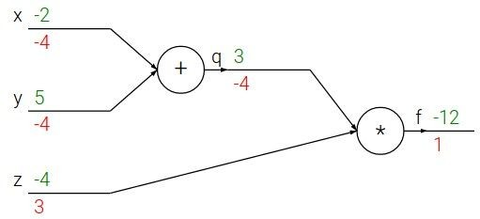

e.g. x = -2, y = 5, z = -4
42

Slide 43





e.g. x = -2, y = 5, z = -4
Want:
43

Slide 44

e.g. x = -2, y = 5, z = -4
Want:
44

Slide 45
e.g. x = -2, y = 5, z = -4
Want:
45

Slide 46

e.g. x = -2, y = 5, z = -4
Want:
46

Slide 47
e.g. x = -2, y = 5, z = -4
Want:
47

Slide 48

e.g. x = -2, y = 5, z = -4
Want:
48

Slide 49
e.g. x = -2, y = 5, z = -4
Want:
49

Slide 50

e.g. x = -2, y = 5, z = -4
Want:
50

Slide 51


e.g. x = -2, y = 5, z = -4
Chain rule:
Want:
-4
1
51

Slide 52

e.g. x = -2, y = 5, z = -4
Want:
52

Slide 53
e.g. x = -2, y = 5, z = -4
Chain rule:
Want:
-4
1
53

Slide 54


activations
f
54

Slide 55


activations
“local gradient”
f
55

Slide 56

activations
“local gradient”
f
gradients
56

Slide 57

activations
“local gradient”
f
gradients
57

Slide 58

activations
“local gradient”
f
gradients
58

Slide 59
activations
“local gradient”
f
gradients
59

Slide 60


Another example:
60

Slide 61


61

Slide 62
62

Slide 63

63

Slide 64
64

Slide 65

65

Slide 66
66

Slide 67

67

Slide 68
68

Slide 69
(-1) * (-0.20) = 0.20
69

Slide 70
70

Slide 71
[local gradient] x [its gradient] [1] x [0.2] = 0.2
[1] x [0.2] = 0.2 (both inputs!)
71

Slide 72
72

Slide 73
[local gradient] x [its gradient] x0: [2] x [0.2] = 0.4
w0: [-1] x [0.2] = -0.2
73

Slide 74

sigmoid function
sigmoid gate
74

Slide 75
sigmoid function
sigmoid gate
(0.73) * (1 - 0.73) = 0.2
75

Slide 76

Patterns in backward flow
Gate | Behavior | Local gradient | Backward behavior
add | distributor | 1 to every input | copies upstream gradient to all inputs unchanged
max | router | 1 to the largest, 0 to the rest | routes the whole gradient to the larger input (winner) only
mul | switcher | the other input's value | each input gets upstream gradient × the other input
mul
add
max
76
Notes:
The add gate is a gradient distributor — it copies the upstream gradient to all of its inputs. The max gate is a gradient router — it sends the gradient only to whichever input was the largest, and zero to the others. The multiply gate is a gradient switcher — each input receives the upstream gradient scaled by the other input.
add gate: gradient distributor: it copies the upstream gradient to all of its inputs
max gate: gradient router: it sends the gradient only to larger input
mul gate: gradient switcher: each input receives the upstream gradient scaled by the other input

Slide 77




Gradients add up at branches
$$a$$
$$x$$
+
$$b$$
If a variable $x$ influences the loss $L$ through two separate paths, say through $a$ and through $b$, then each path contributes a term to the gradient, and you sum the contributions from each path:
$$\frac{∂L}{∂x}=\frac{∂L}{∂a}\frac{∂a}{∂x}+\frac{∂L}{∂b}\frac{∂b}{∂x}$$
(The total effect of nudging $x$ is the sum of its effects along all paths.)
77

Slide 78

Gradients for vectorized code ^{(x,y,z are now}
vectors)
Jacobian matrix: derivative of each element of z w.r.t. each element of x, e.g., for 2D vectors:
$$J=\frac{∂z}{∂x}=\left[\begin{matrix}\frac{∂z_{1}}{∂x_{1}} & \frac{∂z_{1}}{∂x_{2}} \\ \frac{∂z_{2}}{∂x_{1}} & \frac{∂z_{2}}{∂x_{2}}\end{matrix}\right]$$
“local gradient”
f
gradients
78

Slide 79

Vectorized operations
Jacobian matrix
For one training sample
4096-d
input vector
Size of Jacobian matrix:
[4096 x 4096]
4096-d
output vector
79
Notes:
Q2: what does it look like?

Slide 80
Vectorized operations
In practice we process one minibatch (e.g. 100) training samples at once
Jacobian matrix
100 4096-d
input vectors
100 4096-d
output vectors
Size of Jacobian matrix:
[409,600 x 409,600]
80

Slide 81

Optimizers
Stochastic/Mini-batch GD: Speed improvement
- Performs backprop on one training sample, or a mini-batch of samples instead of all samples
- Reduces the number of expensive backward passes
- Helps with getting out of local minima (due to higher gradient noise)
Optimizers
- Gradient Descent
- RMSProp
- Adaptive Momentum Estimation (Adam)
Figure shows GD struggles with oscillations in narrow valleys, leading to slower convergence, while Adam smoothly adjusts its path, leveraging adaptive learning rates and momentum to converge efficiently.
https://www.vizuaranewsletter.com/p/adam-the-most-famous-ml-optimizer
Notes:
Gradient Descent: Updates parameters in the direction of the steepest descent but struggles with slow convergence and uniform learning rates.
Momentum: Introduces a velocity term to smooth updates and accelerate convergence.
RMSprop: Adapts the learning rate for each parameter by normalizing gradients, tackling challenges like exploding or vanishing gradients.

Slide 82
Types of Neural Networks
Notes:
Timestamp: 00:25

Slide 83
Multi-layer Perceptrons
Useful for static input-output relations
More hidden layers → better approximation of more complicated functions
Quick to design and implement

Slide 84

ALVINN
CMU’s Autonomous Land Vehicle In a Neural Network (ALVINN) (1988-89) can drive 70mph on highways.
ALVINN's architecture is a MLP with a single hidden layer.
Input layer is a 30x32 two dimensional "retina" which receives input from camera.
Output layer (30 neurons) encodes the direction the vehicle should travel to keep it on the road (as a 30-class classification task)
Notes:
) is a perception system which learns to control the NAVLAB vehicles by watching a person drive
One of the first examples that neural-networks could do "real-work". It
Each input unit is fully connected to a layer of five hidden units which are in turn fully connected to a layer of 30 output units.
https://jmvidal.cse.sc.edu/talks/ann/alvin.html

Slide 85



MLP vs. Convolutional Neural Network (CNN)
In an MLP, all layers are Fully-Connected
Cannot alter input image size
No translation invariance
No. weight params can grow very large, prune to overfitting
In a CNN, only the last few layers are FC
Each CONV layer extracts increasingly higher level features, followed by FC layers for classification
Translation invariance (object can be anywhere in the image)
Fewer params than MLP
Notes:
Can handle images of arbitrary size
Learn “kernels” that extract increasingly abstract, lower-dimensional features from image pixels.
Used in image processing tasks such as classification, object detection and segmentation.
Each Convolutional layer extracts increasingly higher level features,

Slide 86



Convolutional Neural Network (CNN)
ImageNet Large Scale Visual Recognition Challenge: 1000 object classes, 1.4 M labeled images.

Slide 87

NVIDIA PilotNet
NVIDIA PilotNet (2016) is an end-to-end autonomous driving system that uses a CNN to directly predict steering commands from camera images (as a regression task)
It demonstrated feasibility of learning driving behavior directly from data, paving the way for modern AI-based self-driving technologies.
https://github.com/lhzlhz/PilotNet

Slide 88

Recurrent Neural Network
Regular Feedforward NN
e.g. Image Captioning
image -> sequence of words
e.g. Sentiment Classification
sequence of words -> sentiment
e.g. Machine Translation
seq of words -> seq of words
e.g., video classification
on frame level

Slide 89


Image Captioning: CNN + RNN
CNN processes the input image and generates a feature vector as input to RNN
Last 2 layers of the CNN for classification (FC-1000 and SoftMax) are not used, since we only need the extracted features from the layer FC-4096
Notes:
The last 2 layers of the CNN for classification (FC-1000 and SoftMax) are not used, since we only need the extracted features from the layer FC-4096
At each timestep, sample from the prob vector of the output $yt$ to generate the next input word

Slide 90


Graph Neural Network
GNNs operate on graphs made of nodes and edges.
Information is passed between connected nodes (neighbors) through message-passing.
Graph Convolutional Networks (GCNs) extend the idea of convolution from grid data to graphs.
Useful for tasks like social network analysis, molecule prediction, and recommendation systems.
GNN
DCN
https://www.geeksforgeeks.org/deep-learning/what-are-graph-neural-networks/
Notes:
Models or uses ‘manifold embeddings’ on non-Euclidean domains like graphs, meshes and manifolds - geometric inductive bias
Captures various forms of invariance and equivariance (e.g. Grids, Groups, Graphs, Geodesics, and Gauges)
Used in e.g. 3D object recognition, protein structures, medical imagine, etc.\
capture relationships, dependencies and interactions between entities. https://www.geeksforgeeks.org/deep-learning/what-are-graph-neural-networks/
They

Slide 91

Transformer
Uses attention mechanisms to capture relationships between inputs
Processes entire sequences at once instead of step by step
Improves performance on tasks involving context and dependencies
Basis for modern Foundation Models (LLMs/VLMs…)
Notes:
https://www.geeksforgeeks.org/machine-learning/getting-started-with-transformers/
They do this by learning context and tracking relationships between sequence components.

Slide 92

(CVPR 2021)
CNNs
Transformers
CNNs, Transformers,
RNNs
Tesla’s Full Self-Driving (FSD) Chip
https://www.thinkautonomous.ai/blog/how-tesla-autopilot-works/

Slide 93
Training tips

Slide 94
Overfitting & Underfitting
The real troublemakers in ML in general!
Underfitting: When the model fits the training data not well enough
- Empirical risk is high, actual risk is high
- Training loss is high, testing loss is not optimal
Overfitting: When the model fits the training data too closely (incl. noise)
- Empirical risk is low, actual risk is high
- Training loss is low, testing loss is not optimal
- e.g. An D-degree polynomial can fit D-1 training points with zero error

Slide 95

Overfitting & Underfitting
More complex models (e.g. more layers, neurons per layer) -> higher likelihood of overfitting
Image source: https://docs.aws.amazon.com/machine-learning/latest/dg/model-fit-underfitting-vs-overfitting.html

Slide 96
Validation
Split your training set into two!
- New train set
- Unseen-by-the-model “validation”set
Train Set
Test Set (unseen)

Slide 97
Validation
Split your training set into two!
- New train set
- Unseen-by-the-model “validation”set
- e.g. 80-20 split (Note: split ratio depends on the model, task and data)
Train Set
Validation Set
Test Set (unseen)
80%
20%

Slide 98
k-fold Cross-validation
Split training set into k-segments, iteratively train and validate with each segment.
- Accounts for irregularities in training set
- “Gold standard” for evaluating generality of neural network models
Train Set

Slide 99
k-fold Cross-validation
Split training set into k-segments, iteratively train and validate with each segment.
- Accounts for irregularities in training set
- “Gold standard” for evaluating generality of neural network models
e.g. k=5 (5-fold cross-validation)
Train Set
Train Set
Train Set
Train Set
Train Set

Slide 100
k-fold Cross-validation
Split training set into k-segments, iteratively train and validate with each segment.
- Accounts for irregularities in training set
- “Gold standard” for evaluating generality of neural network models
e.g. k=5 (5-fold cross-validation)
Validation Set
Train Set
Train Set
Train Set
Train Set

Slide 101
k-fold Cross-validation
Split training set into k-segments, iteratively train and validate with each segment.
- Accounts for irregularities in training set
- “Gold standard” for evaluating generality of neural network models
e.g. k=5 (5-fold cross-validation)
Train Set
Validation Set
Train Set
Train Set
Train Set

Slide 102
k-fold Cross-validation
Split training set into k-segments, iteratively train and validate with each segment.
- Accounts for irregularities in training set
- “Gold standard” for evaluating generality of neural network models
e.g. k=5 (5-fold cross-validation)
Train Set
Train Set
Validation Set
Train Set
Train Set

Slide 103
k-fold Cross-validation
Split training set into k-segments, iteratively train and validate with each segment.
- Accounts for irregularities in training set
- “Gold standard” for evaluating generality of neural network models
e.g. k=5 (5-fold cross-validation)
Train Set
Train Set
Train Set
Validation Set
Train Set

Slide 104
k-fold Cross-validation
Split training set into k-segments, iteratively train and validate with each segment.
- Accounts for irregularities in training set
- “Gold standard” for evaluating generality of neural network models
e.g. k=5 (5-fold cross-validation)
Result = average over all validation passes
Train Set
Train Set
Train Set
Train Set
Validation Set

Slide 105


Training curves
Important to plot!

Slide 106
Training curves
Important to plot!(!!!!)

Slide 107
Training curves
Important to plot!(!!!!)
Shows if and how fast your model is learning on task-relevant metrics
- e.g. loss, accuracy, AUC, F1 score
- Plot scores over training epochs

Slide 108
Training curves
Shows if and how fast your model is learning on task-relevant metrics
- e.g. loss, accuracy, AUC, F1 score
- Plot scores over training epochs
May indicate potential over and underfitting

Slide 109

Reading training curves
If
validation loss > training loss
then often the model is good!
Low loss == Better

Slide 110

Reading training curves
If
validation loss >> training loss
then often the model is overfitting
Low loss == Better

Slide 111

Reading training curves
If
validation loss ~ training loss
then often the model is underfitting
Low loss == Better

Slide 112

Reading training curves
If
validation loss < training loss
then something is very wrong!
Low loss == Better

Slide 113


Weight Regularization
L1/L2 Regularization helps make weights sparse (L1), or have small magnitude (L2):
Dropout (on when training, off when testing/deploying)
Early stopping

Slide 114

Parallelization:
Speeding up NNs
Main math operation in NNs:
- Matrix-vector multiplications
- Element-wise nonlinear activation functions
Parallelization can be used to massively speed up learning and deployment!
- Multi-core CPUs
- Graphics processing units (GPUs)
- Tensor processing units (TPUs)
- FPGAs
https://cloud.google.com/blog/products/ai-machine-learning/an-in-depth-look-at-googles-first-tensor-processing-unit-tpu

Slide 115
Where NNs thrive
Limits of NNs
> Very data hungry - “Garbage in, garbage out”
> Expensive to train (depending on size)
> Non-extensible and specialized to a range and task
- Add one more neuron → needs fine-tuning
- Undefined behaviour on out-of-distribution examples
> Statistical/correlation inference
> There exists a lot of good quality (labelled) training data
> Parallelizable training and deployment
Notes:
Tasks without expansion (input-output fixed)
> Specialized tasks
> Good in-range performance IRL
> No causal relations

Slide 116

Frontiers
Shallow NNs → Deep NNs with hundreds of layers, billions of weights
CNNs → Transformers → Foundation models (LLMs/VLMs/VLAs)
Supervised Learning → Self-Supervised Learning, Reinforcement Learning, RL with Human Feedback…

Slide 117
Backup slides

Slide 118



\lambda = regularization strength (hyperparameter)
Weight Regularization
In common use: L2 regularization L1 regularization
Elastic net (L1 + L2)
Max norm regularization (might see later) Dropout (will see later)
Section 3 -
Section 3 - 23

Slide 119


Recurrent Neural Networks
Outputs go back and forth between neurons (loops exist in the graphs)
Approximates dynamical systems
- Any time-based function
- Any data that can be modelled as being “ordered”
Used often in time-series tasks like signal processing, natural language processing
Several types: Fully-connected, LSTMs, GRUs, reservoirs
An LSTM cell schematic. Adapted from: doi.org/10.4233/uuid:dc73e1ff-0496-459a-986f-de37f7f250c9
Echo state network schematic. Adapted from www.scholarpedia.org/article/Echo_state_network

Slide 120
Convolutional Neural Networks
Notes:
, i.e. ‘tensors’ (multi-dimensional arrays) that convolve over n-dimensional data to
Translational invariance: Cand still be found

